Slide 1
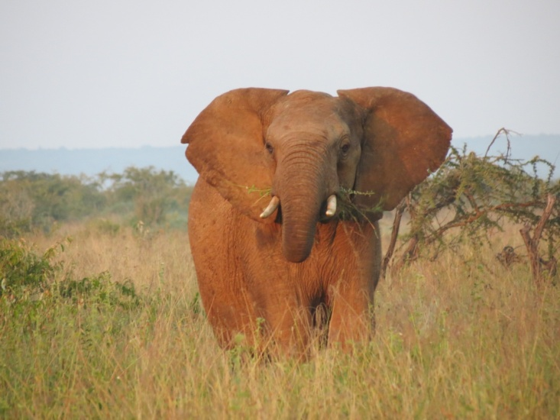
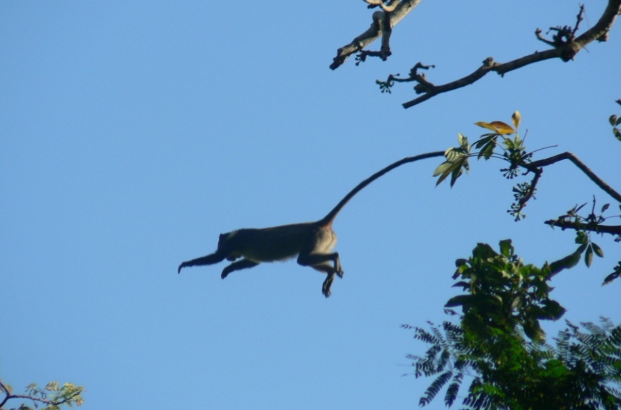
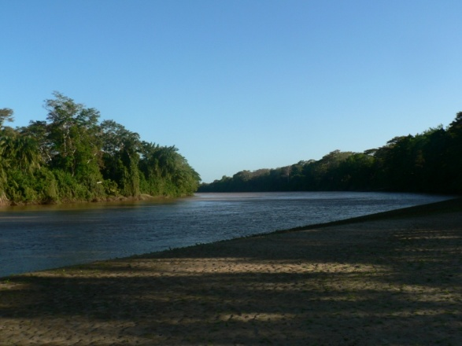
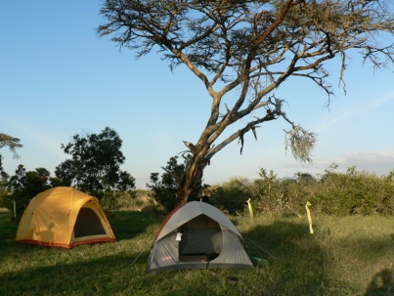
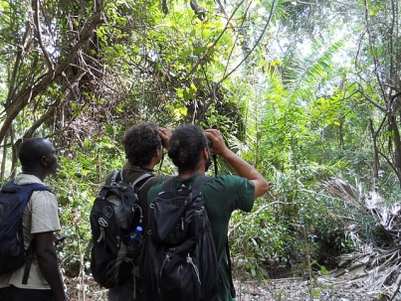
Primatology, Wildlife Ecology and Conservation Field School
When: 1-27 August, 2013
Where: Multiple locations in Kenya
Tuition fee (2012), for 6 credits
NJ resident: 4350$ Out of state: 5350$
For information, contact: Dr. Luca Morino
morino@rutgers.edu

